Slide 1
K-MEANS KAPITAL LIMITED.
Analysis and Classification Model for the Customer Churn
By Daniel Ogando
github: https://github.com/kdizz/Phase-3-Syriatel-churn-project

Slide 2
1. Business Understanding.
We at K-Means Kapital ltd have been tasked with a dataset from a leading telecommunications provider who is undergoing some challenges and would wish to us to conduct an analysis from their customer data.
The challenge that Syriatel is facing s that they are losing customers and ultimately impacting their revenues.
What we shall do for this data is to conduct an analysis on the usage trends and ultimately help predict potentially exiting customers that way they may be able to have a better picture of their busness health going forward.

Slide 3
2. Direction of Analysis
We need to analyze variables in the data from Syriatel thereby helping us to;
Determine the relationships between the variables.
The distribution of the variables.
Build a model to predict churn.
We have decided to focus on churn as our target variable.

Slide 4
Insights.

Slide 5
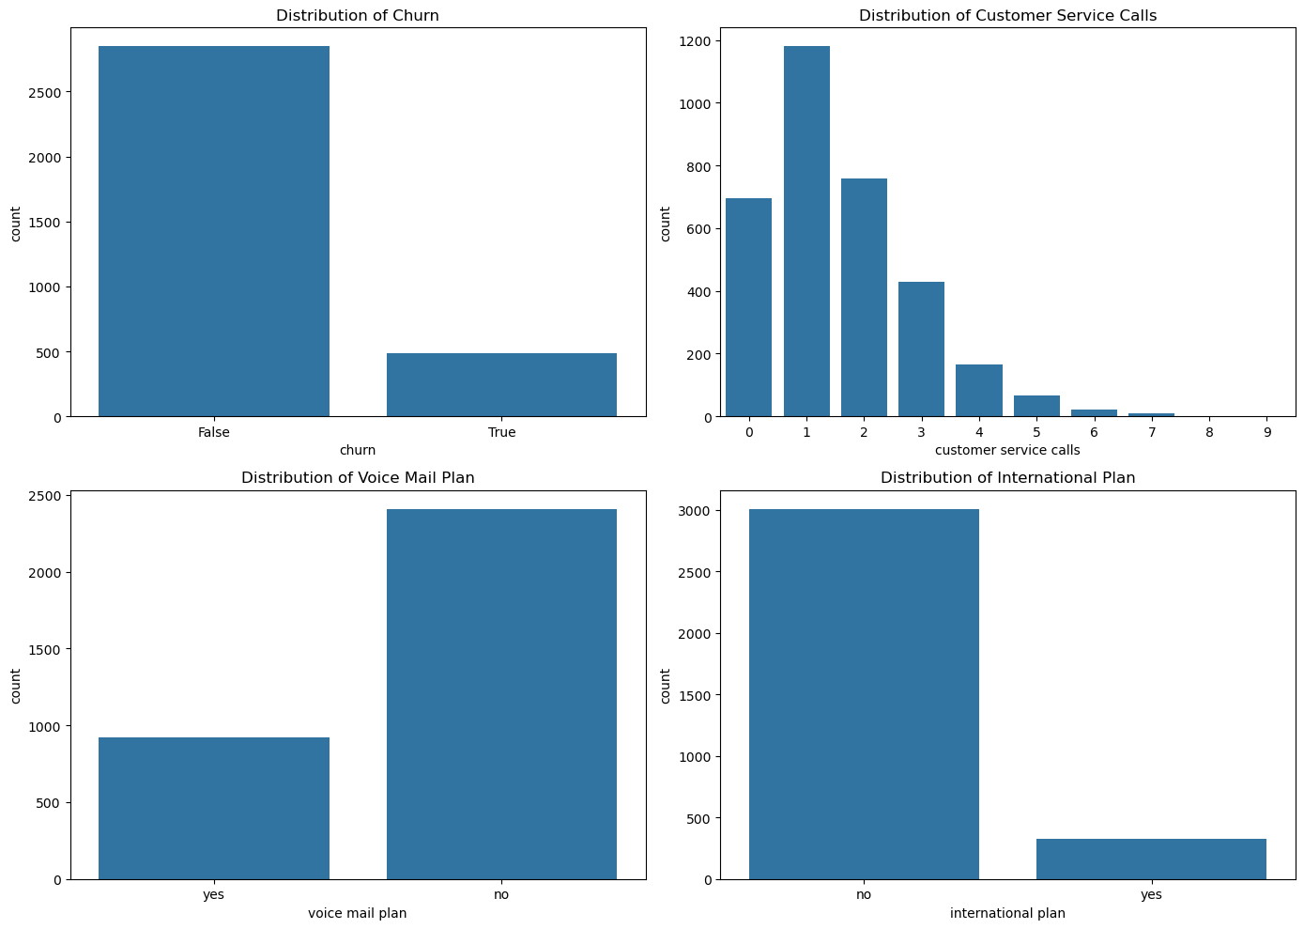
Distribution of categorical variables.
As we can see from the graphs here,
We can deduce the following;
They have retained most of their customers however the churn, though small could be significant in the long-run.
Most customer issues were solved by the 4th call and also a significant number of clients about 700 had no issues to reach out for.
Only about a third of their clients have a voicemail plan.
A very small amount of clients have an international plan and as such we can say that their services are mostly used domestically.

Slide 6
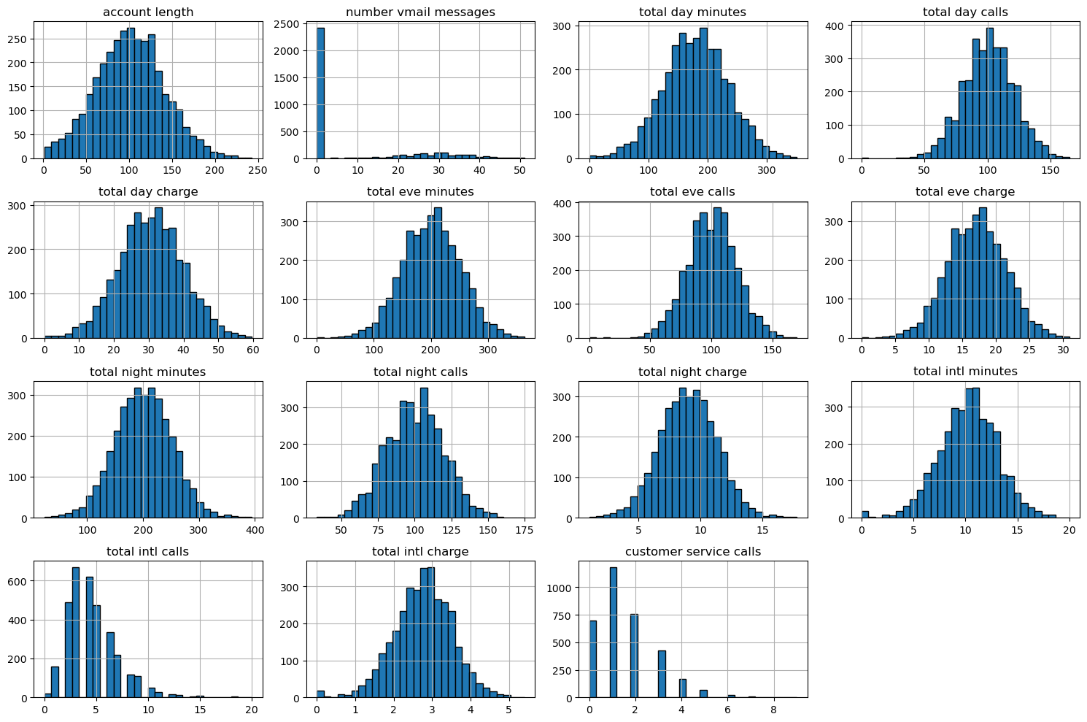
Distribution of NUMERIC variables.
As we can see from the graphs here,
We can deduce the following;
The service usage is fairly normal, this is because we are seeing normal distribution especially on; day calls, evening calls, night calls and international calls.
The charges they’ve issued clientele match up o the usage and as such there are no mispricing issues.

Slide 7
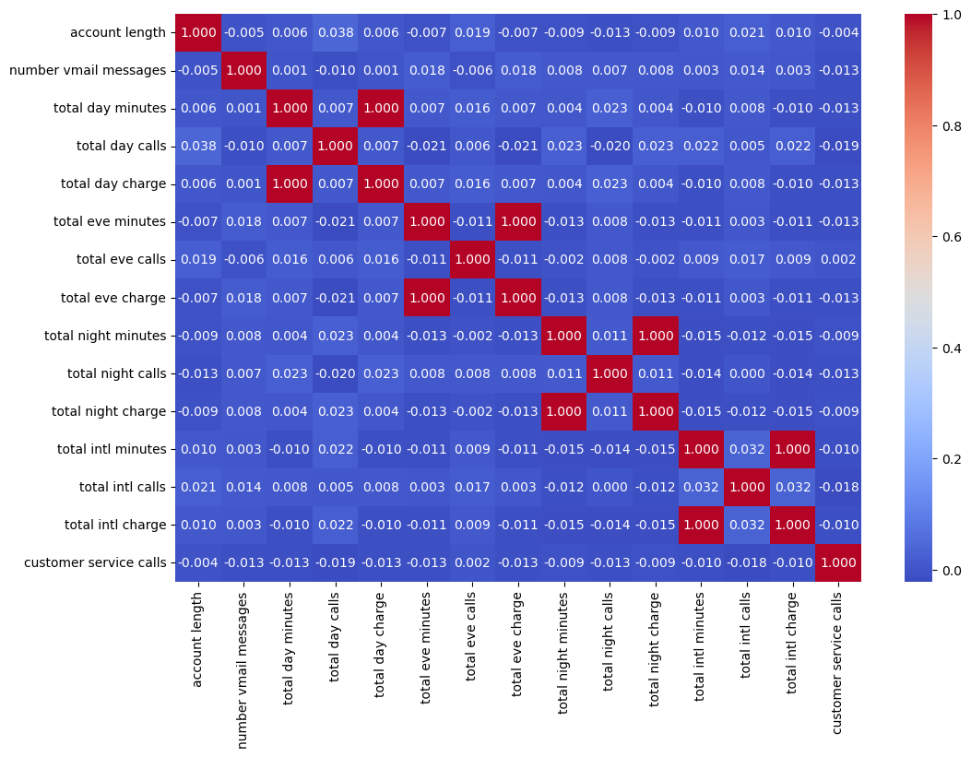
CORRELATION of NUMERIC variables.
As we can see from the table here,
We have done a correlation matrix for all the numeric variables.
We can deduce the following;
There is very little relationship between the variables except for the charge and minutes.
The assumption made in the previous slide in regards to proper pricing of their products is further supported by this.

Slide 8
CROSS-ANALYSIS.

Slide 9
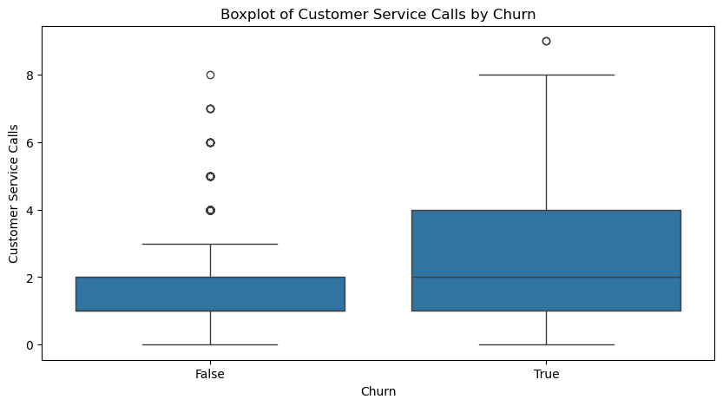
CHURN VS CUSTOMER SERVICE CALLS.
As we can see from the box plot here,
The distribution of the customer service calls split between the churn values showing median, mean, quartiles and outliers.
We can deduce the following;
There customers that left for the most part made attempts to reach out to customer service. This could mean the service may have had an issue for them that wasn’t solved or wasn’t sorted to their satisfaction.

Slide 10
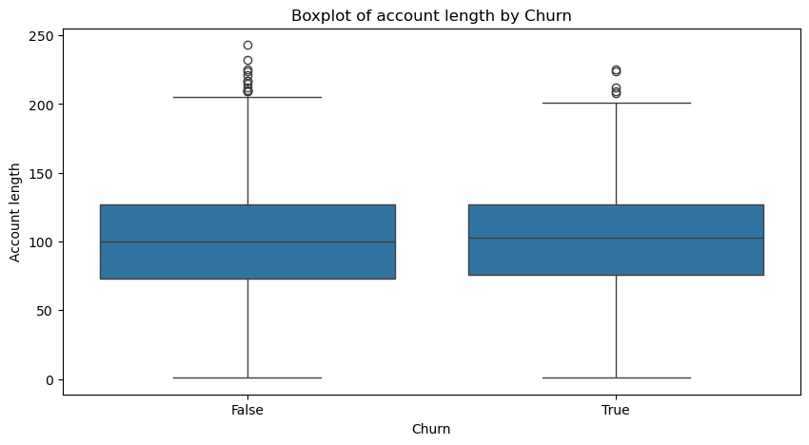
CHURN VS CUSTOMER SERVICE CALLS.
As we can see from the box plot here,
The distribution of the account length split between the churn values showing median, mean, quartiles and outliers.
We can deduce the following;
Customer duration/loyalty isn’t a strong supporting factor for the churn or retention and as such we can say that no matter how long they’ve had a customer, it doesn’t mean that they shall always stay.

Slide 11
Classification modeling.

Slide 12
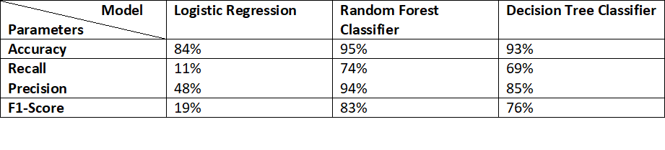
Summary of models
From the above table, we tried to implement and tune 3 different model types so as to see which one best fit the data and would act as a reliable classifier that Syriatel could use for analysis of their Churn.
Logistic Regression performed poorly and as such we don’t recommend it for this purpose.
Random Forest Classifier performed the best yielding the most reliable predictions. We highly recommend this model.
Decision Tree Classifier was also came close but we shall not pick this one
Definitions:
Accuracy: The percentage of correctly predicted cases out of all cases.
Precision: Out of all predicted positives, how many were actually positive.
Recall: Out of all actual positives, how many were correctly predicted.
F1 Score: A balance between precision and recall (useful for imbalanced data).

Slide 13
Conclusion, Recommendations.
The company should rely on our Random Forest Classifier when making analysis.
Also, they need to focus on items around customer service and analyze the issues raised so that they may be able to correct these along side implementing customer retention strategies and using the model to gauge effectiveness.

Slide 14
Q&A?
Presented by: Daniel Ogando
www.linkedin.com/in/daniel-ogando/

